Slide 1
Useless Lockbox
Team 9 – Daniel Diaz, Dwayne Hoeck, Ha Tran, Thanh Le

Slide 2
Need and Motivation
Privacy and security have become major concerns in society today. Whether it be a teenager trying to keep a diary hidden or an adult keeping money away from a less than trustworthy roommate, a lockbox is a good way to go.
Unfortunately, lockboxes are obvious and sometimes bring with them curiosity as to what is inside. An interesting and elegant way to keep a lockbox without arousing much suspicion is needed.
Privacy
Teenagers
Roommates
Entertaining
Not identifiable as lockbox at first glance
Environmentally friendly
Wood design
Aesthetically pleasing
Side table decoration

Slide 3
Objective
Plan
Design
Prototype
Design PCB
Create hardware box
Test

Slide 4
Alternatives
Normal lock box
Safe
Conventional useless box
Conventional stash box

Slide 5
Requirements

Slide 6
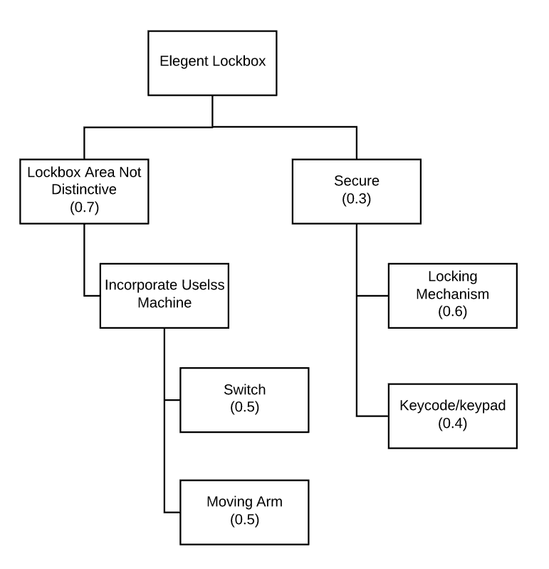
Approach
Useless machine feature incorporation: Simple box with a switch and a moving arm. When the switch is flipped, the arm moves and flips the switch back to the starting position.
Lock box feature: The switch will enable a keypad and LCD screen. If the correct passcode is entered a solenoid will activate and the “hidden” lockbox compartment will open. If the passcode is incorrect a moving arm will flip the switch back to the off position.

Slide 7
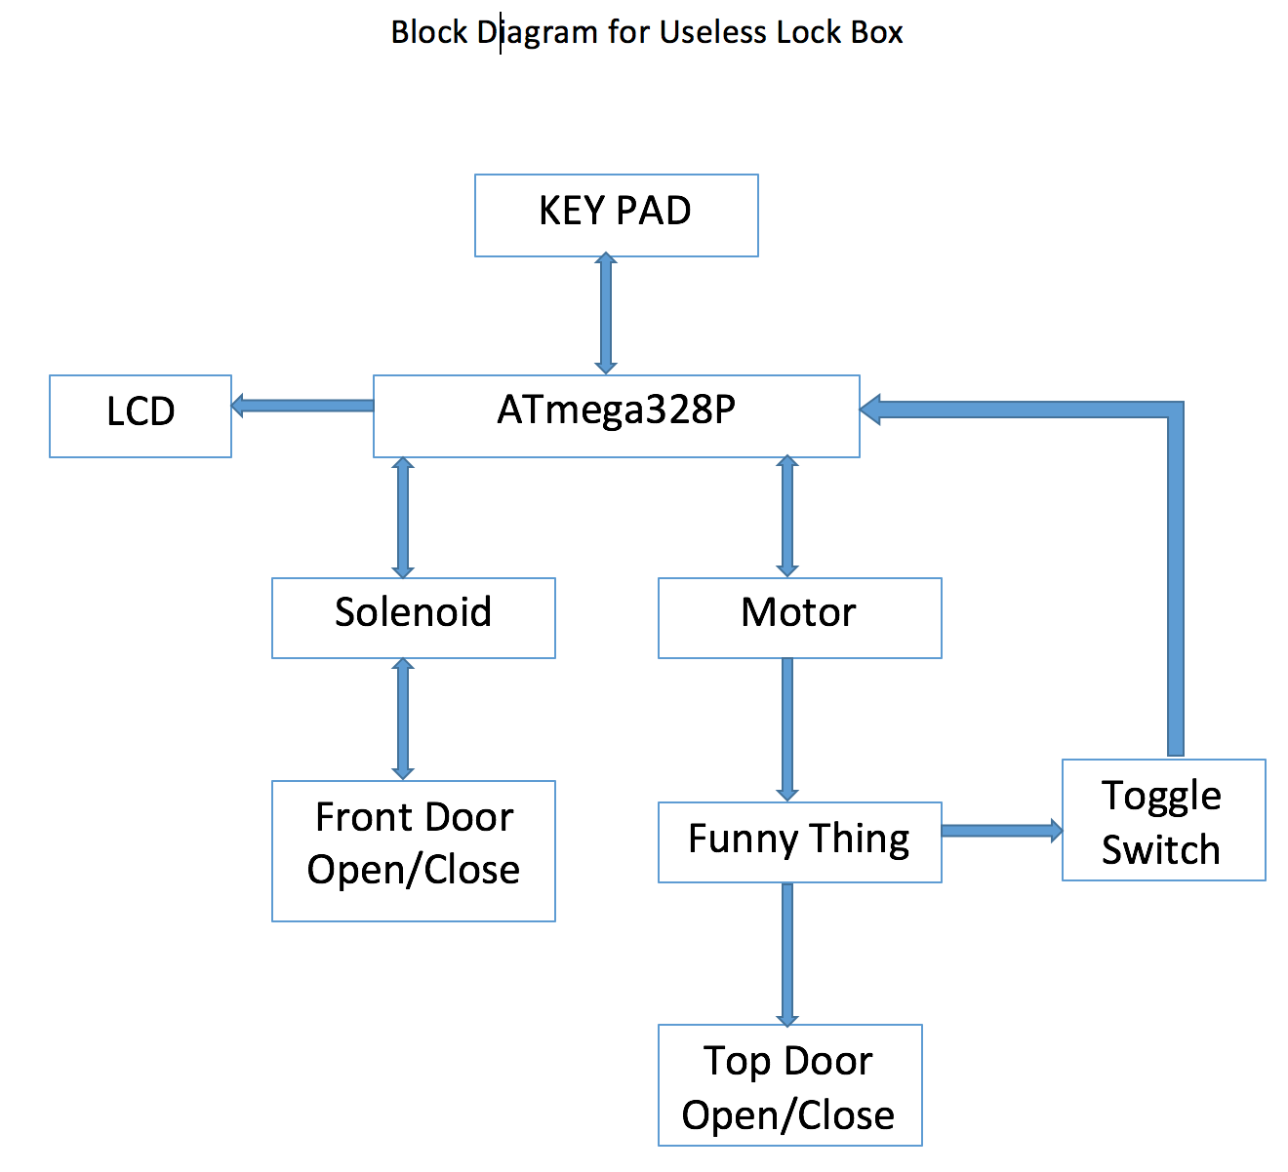
Approach
Some more description here to link to how we schedule the project.

Slide 8
Project Schedule

Slide 9
Design Process

Slide 10
Design Process

Slide 11
Design Process

Slide 12
Trade-off and Decision Making

Slide 13
Implementation
Major components:
Microprocessor: ATmega328P
Locking Mechanism:
Key Pad
16x2 LCD Display
Solenoid
Useless Box Mechanism:
Switch
Servo

Slide 14
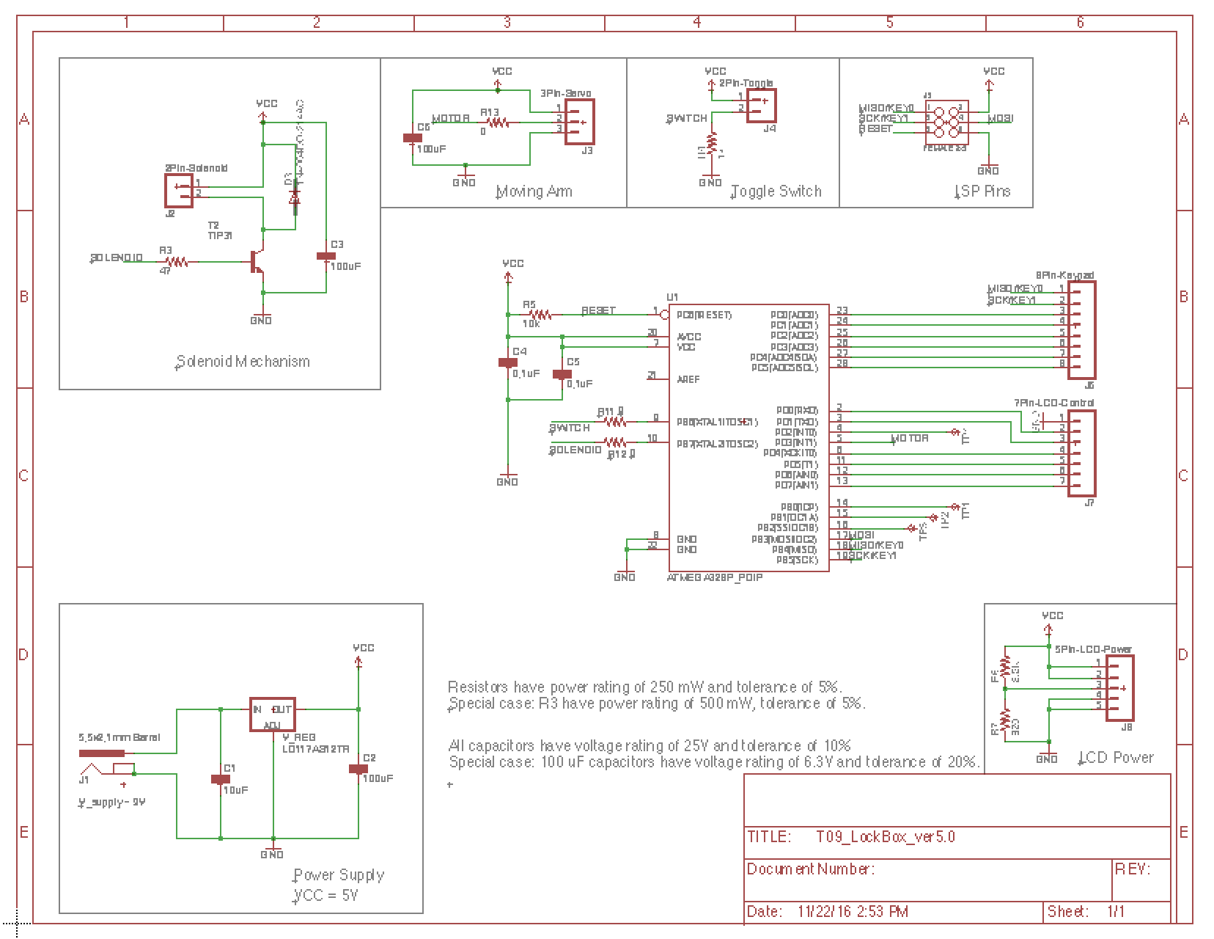
Implementation - Schematic

Slide 15
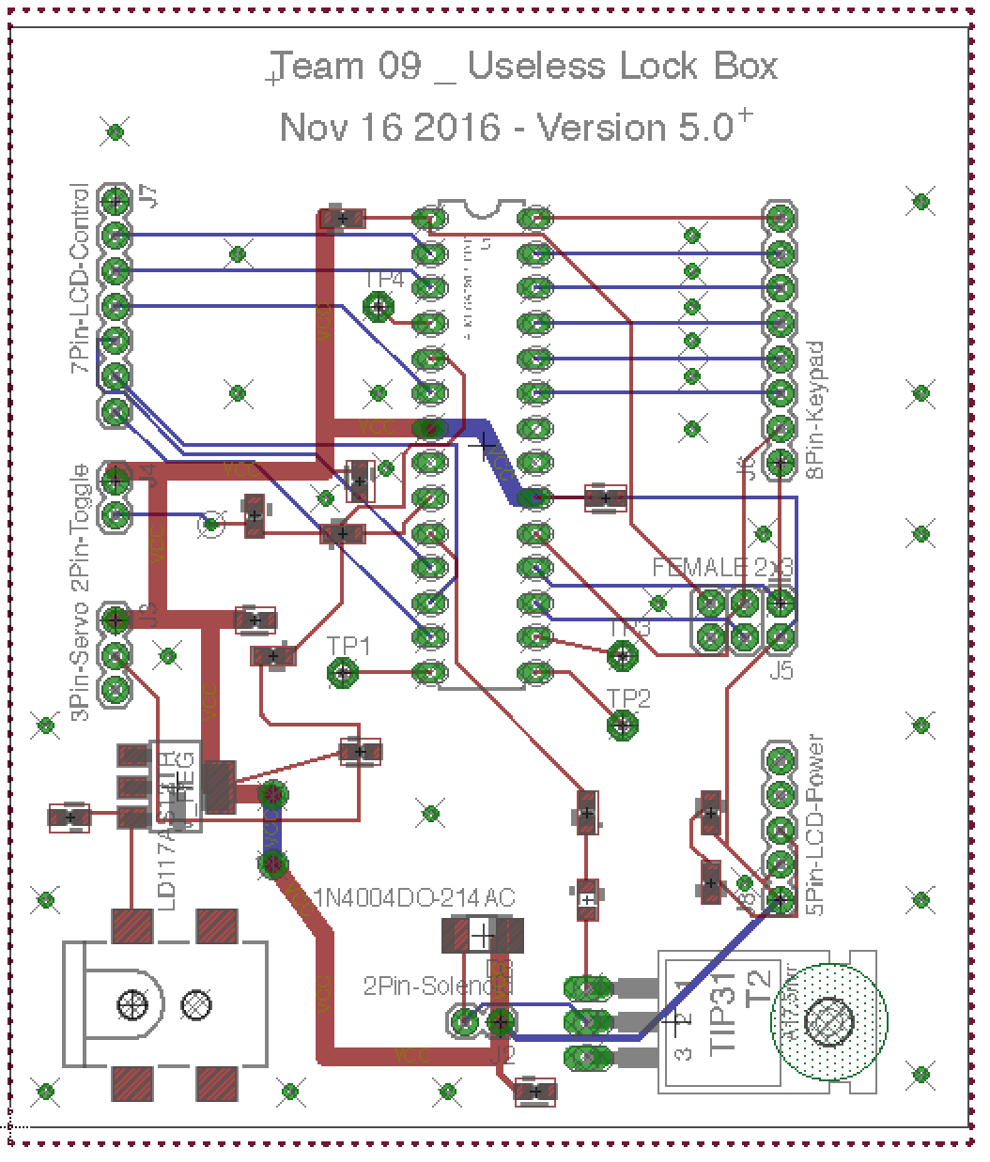
Implementation – Board Layout

Slide 16
Implementation – Code

Slide 17
IP and Prior Work

Slide 18
Testing

Slide 19
Result

Slide 20
Contribution and Lessons Learning

Slide 21
Thank you

